Slide 1

Species distribution modelling using MAXENT
DR
Modelling your species habitat suitability under present & future climate conditions
Systematics & Biodiversity, 2020

Slide 2

SDM Practical
Don’t be afraid to
How will it work:
Different rooms for each group to work together
Talk with each other, help each other -> it’s not a competition
Teaching staff will come in to help during the practical – People with mac, let us know!
Possible Intermezzo’s:
Introducing the problem
And setting up your workspace (NOW)
Setting up MAXENT and JAVA & Quick data download guide (Nuno - By group, if needed)
Downloading & exploring occurrence data (Nuno - by group, if needed)
Environmental data & selecting your Environmental variables (Nuno)
Starting up MAXENT (Nuno)
Exploring MAXENT outputs (Nuno)
Creating change maps in ArcGIS (Maarten)
My outputs (Nuno – if there is time)

Slide 3
SDM Practical
Occurrence
MAXENT
Present
Model performance
Enviroment
Future scenario
Change map
The practical tutorial is based on a bat species -> adapt it to your species
There is an R script for each section -> you mostly have to adapt the folder paths

Slide 4

SDM Practical
Think before starting!
What do you want to know about your species?
How do you experiment it?
What scenarios are you interested in testing?
For your report, be explicit on the hypothesis:
Research objectives: How does climate change affect the habitat of X?
HO: There is no change in the suitable area of species X
HA: There is an increase/decrease of suitable area of species X
You are here to learn, but for the report design experiment in function of the hypothesis

Slide 5
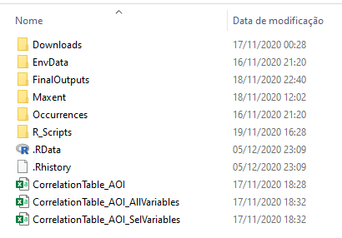
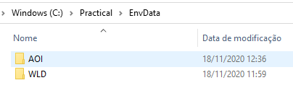
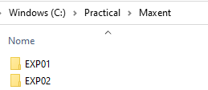
SDM Practical
Be organized!
Saves time later for your report!
Saves time in adapting the code!
Think of your folders as a “database”
Avoid “funky” characters and spaces
Programming languages do not like them and crash often because of it
If you follow our suggested structure your code editing is mimized
R Script: OO_SettingUpWorkspace.R

Slide 6
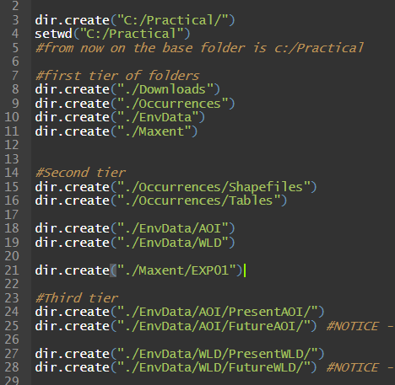
SDM Practical
The most important command are the first two:
Dir.create - creates a new folder in c:\Practical
Setwd –”set work directory”
Once you do that – all your files have a “relative path” meaning:
Folders are an folder X, located in relation to c:\Practical
The rest create different folders
Does not overwrite if it is already existing
Notice:
You can have multiple scenarios but each has to be in its own folder, with an unique name:
MAXENT uses the folder name for the projections
But it needs that all variables inside have the same name as the files used for training

Slide 7
Setting up MAXENT & JAVA
And starting by Downloading the climate data during lunch

Slide 8
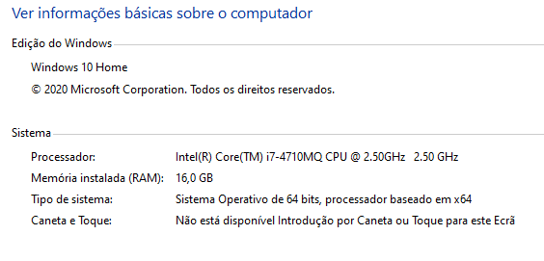
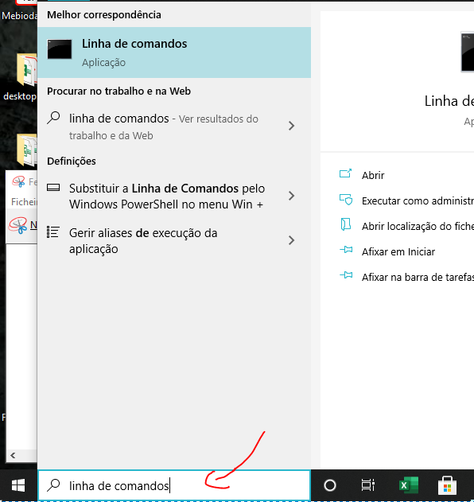
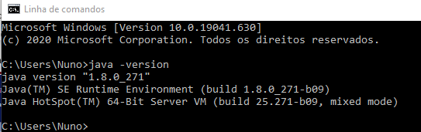
Setting up Java
For Java:
Go to https://www.java.com/en/download/help/download_options.xml
Follow the steps to download and install the software for your operating system
Unsure about your OS? In windows, go to your system properties:
Check Java installation:
Go to the search box and write “Command line” (or in your own OS language)
On the DOS box that opens, type: java – version
If all is well, you will have a similar output

Slide 9
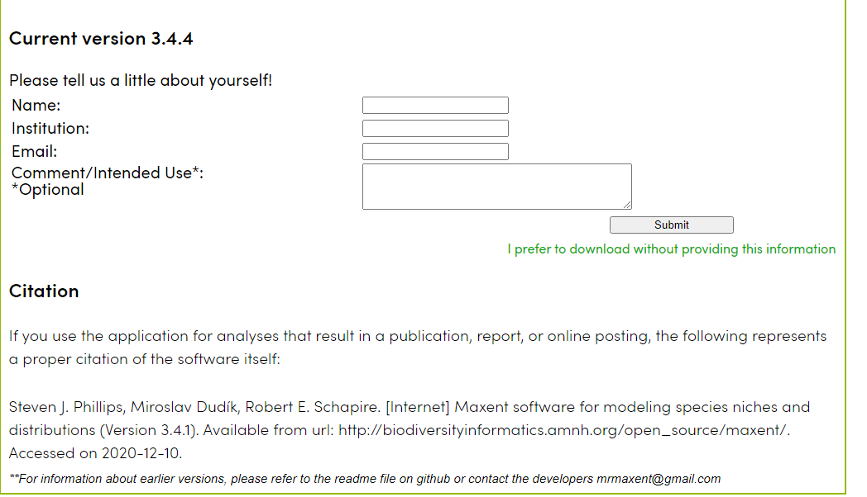
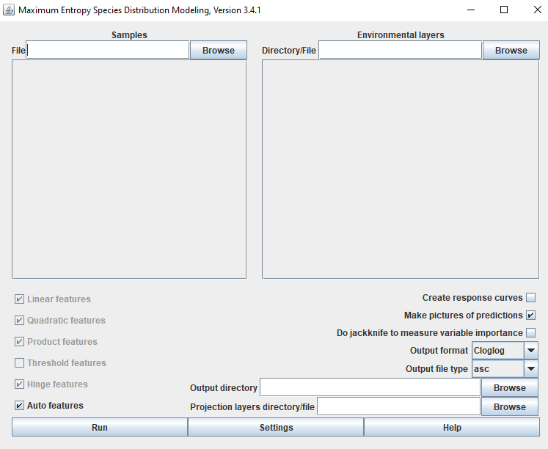
Setting up MAXENT:
Go to https://biodiversityinformatics.amnh.org/open_source/maxent/
Tell them a bit about yourself
You can lie, but remember it is a sin
Download the software and unzip it to a folder
Click on the .Jar file to activate
If you see the screen, should be fine
PS: Would be nice to cite them on your report

Slide 10
Downloading the climate data
Go to the manual
It’s already in brightspace!
Follow the steps to download the climate data detailed there
In summary:
Go to https://www.worldclim.org/
Download:
Historical bioclimatic data (bio 5m) at 5 minutes resolution
Future scenario bioclimatic data (bc) data: IPSL-CM6A-LR / SSP370

Slide 11
Occurrence data

Slide 12
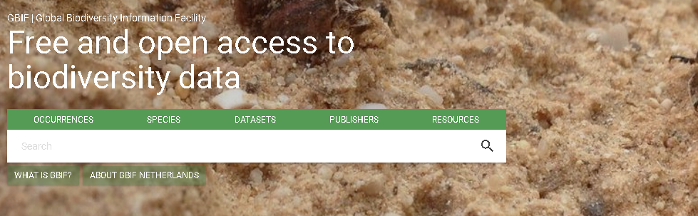
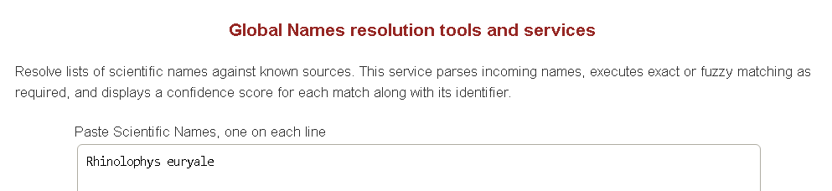
SDM Practical
Occurrence data:
https://www.gbif.org/
It is supposed that you already downloaded and prepared the occurrence data
No need to repeat this
If you are satisfied, move to the next step
Remember though, we would like to know that you explored your data
Notice – everything is useful for the report:
Did you find synonyms and choose to use them?
Did you find errors on your report and corrected them?
Did you find spatial biases?
Species name here
https://resolver.globalnames.org/

Slide 13
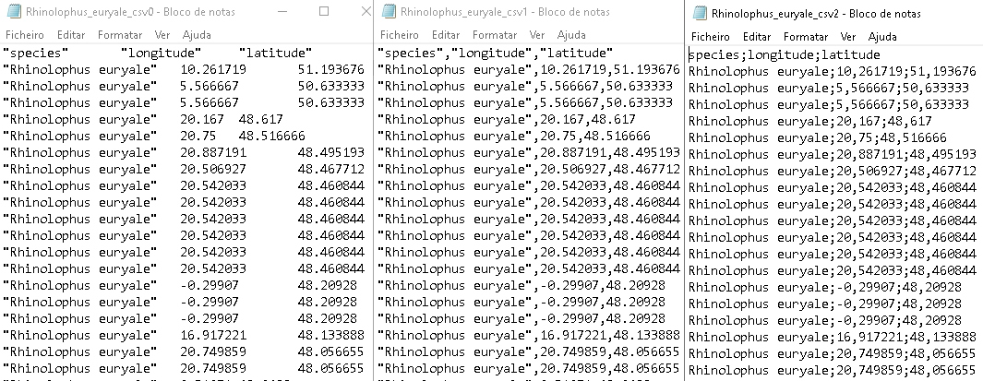
SDM Practical
Important explanation about .csv files:
.csv files are usually stored in different format depending on your operating system
Please keep a US Version – MAXENT requires it
How to correct: Explained in detail in the manual and the classes
MAXENT expects:
Species name, longitude, latitude
Tab delimited
US
EU(general)
Recommended:
Keep all versions, saved with different names
E.g. Species_csv1.csv or species_csv2.csv

Slide 14

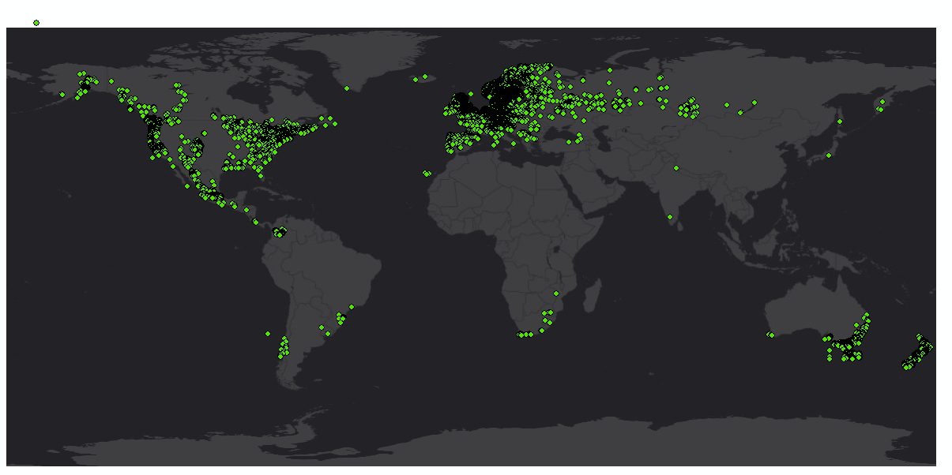
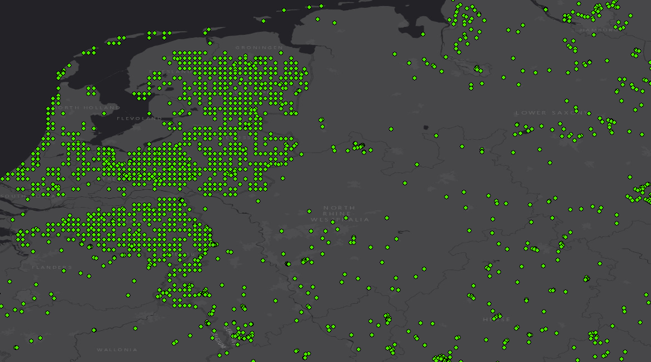
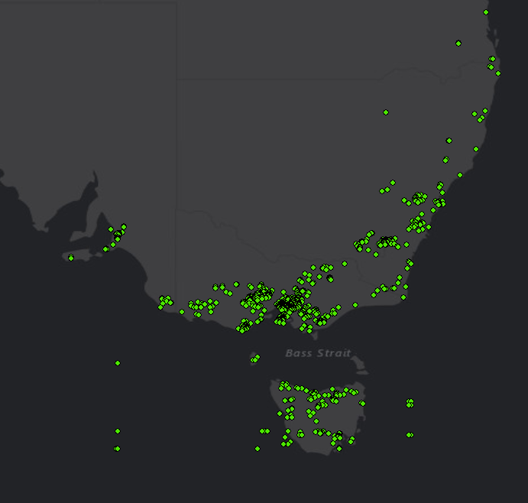
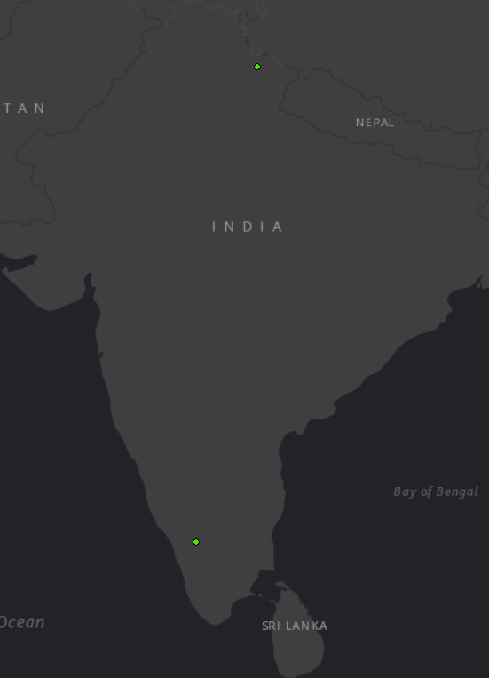
SDM Practical
Amanita muscaria
Native range?
Was the species introduced here?
Different sampling strategies
In a GIS you can easily clean the obvious errors
Further explore if the data “makes sense”
When satisfied, export back to csv (check GIS notes)

Slide 15
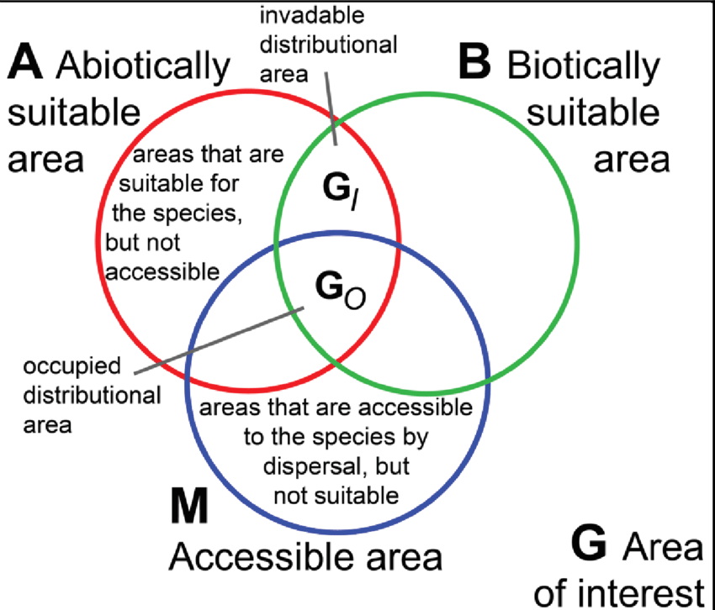
SDM Practical
Amanita muscaria
Example problems:
What is the real ecological niche of the species?
Can the native range predict the invaded distribution?
How does the sampling design affect the model prediction?
You are free to explore these for your case

Slide 16
Downloading and preparing environmental data

Slide 17
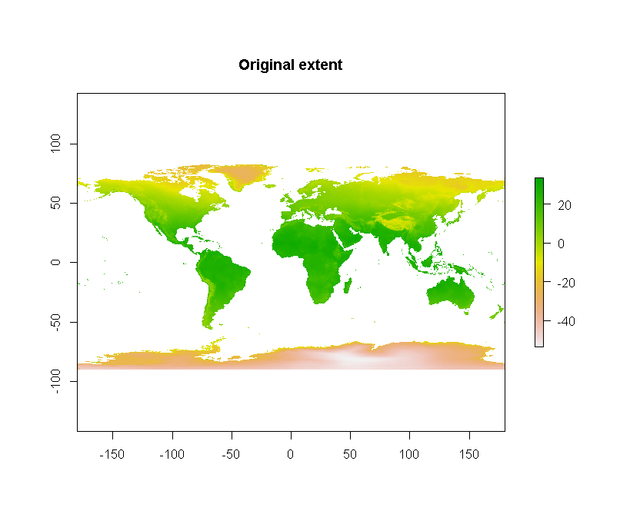
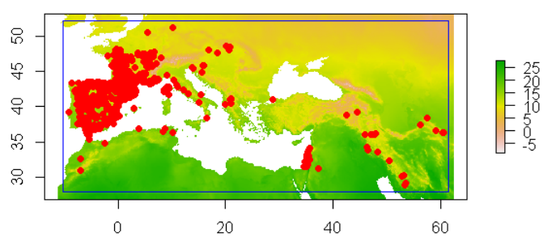
SDM Practical
Downloading files from Wordclim
Present and future scenario
Within R: 01_CroppingEnvVariables.R
Fetching the environmental variables
Cropping to study area
Exporting files in .asc format for MAXENT
When do the variables do not have to be cropped?
When your species has a global distribution.. It becomes moot

Slide 18
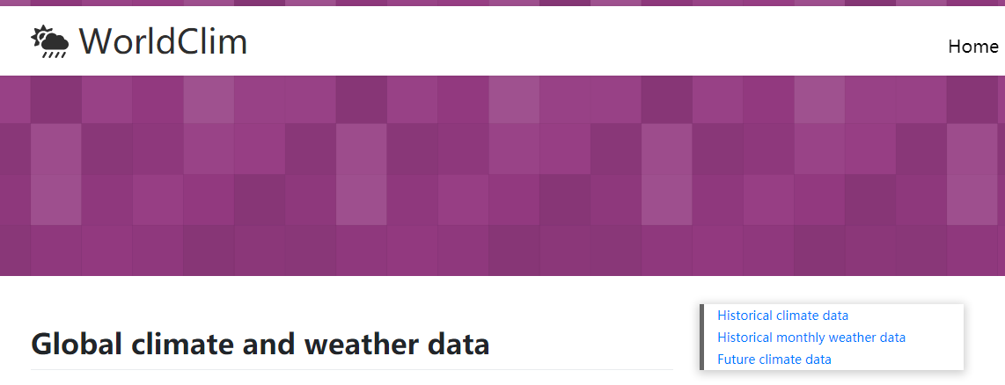
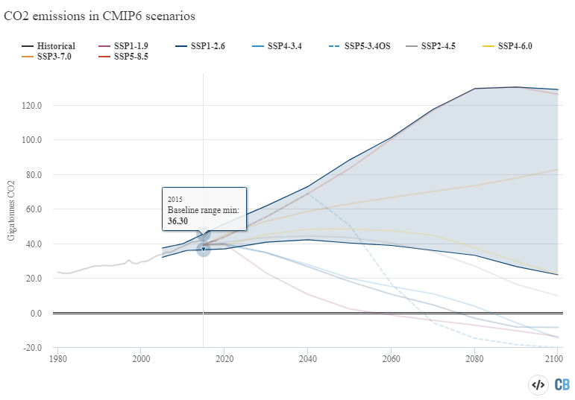
SDM Practical
Worldclim data
World Climate Research Programme (1980 - Present)
Method: Hijmans, 2005 (Also Raster package R)
Provides historical data (present)
1970 ~ 2000
Represents the “recent trend” in climate
Shared Socio-economic pathways (Riahi, 2016)
Represent different future scenarios regarding CO2 emissions
Available scenarios:
SSP1: Sustainability – “taking the green road”
SSP2: “Middle of the road”
SSP3: Regional rivalry – “A rocky road”
SSP5: Fossil-fueled Development – “Taking the highway”
Worldclim
Carbon brief

Slide 19
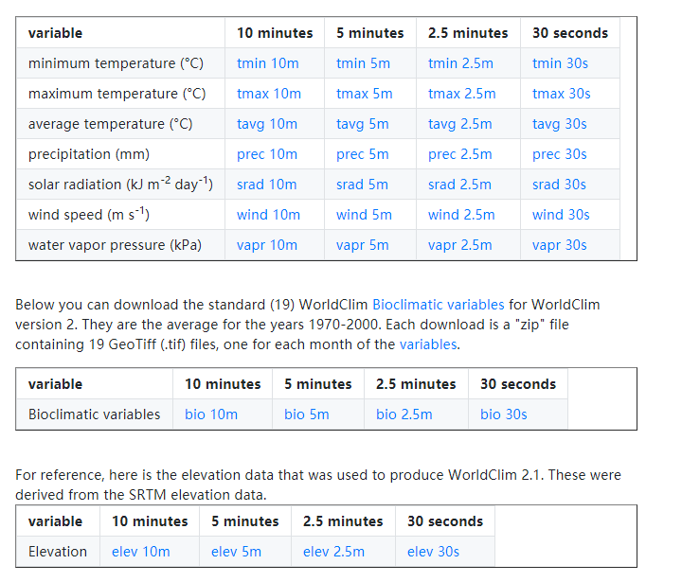

SDM Practical
$${SideLength}_{meters}≈\left({WclimRes}_{seconds}∙\frac{{EquatorEarthRadius}_{meters}}{360°}\right)$$
On historical data:
The 10, 5, 2.5 minutes and 30s represent spatial resolution
Minutes of degrees in DMS geographical coordinates format
We will use:
5 minutes resolution (~10km in the equator)
Bioclimatic variables
Select the Bioclimatic variables
Representative of seasonal trends that are somehow significant to the physiological constraints of species

Slide 20
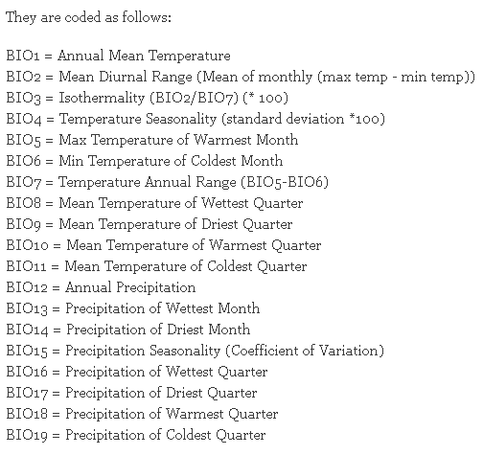
SDM Practical
19 different variables
Represent relevant ecophysiological quantities for temperature and precipitation
Keep note of these variable names!
You’ll have to select variables based on:
Ecological knowledge (first and foremost!)
Statistical tests

Slide 21
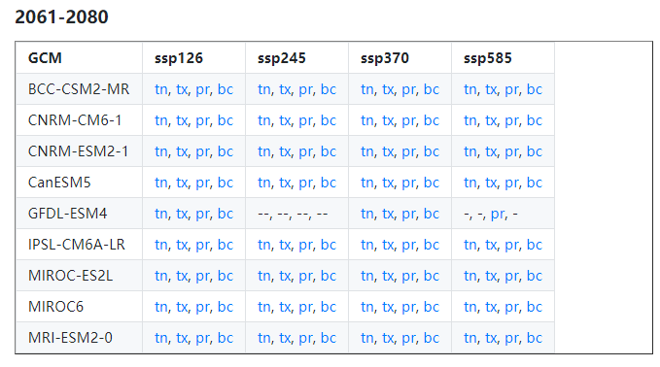
SDM Practical
Future scenarios
On the tutorial we use: SSP3 Regional Rivalry - “rocky road”
Global Circulation Model:
Predictions generated fromomplex physical simulations of climate models
We used IPSL-CMC6-LR – use this GCM also
5 minute resolution!
Tutorial time interval: 2061-2080
~50 years from today.
Use at least this scenario but you are free (and encouraged) to try more
Time interval used
bc – Bioclimatic variables

Slide 22
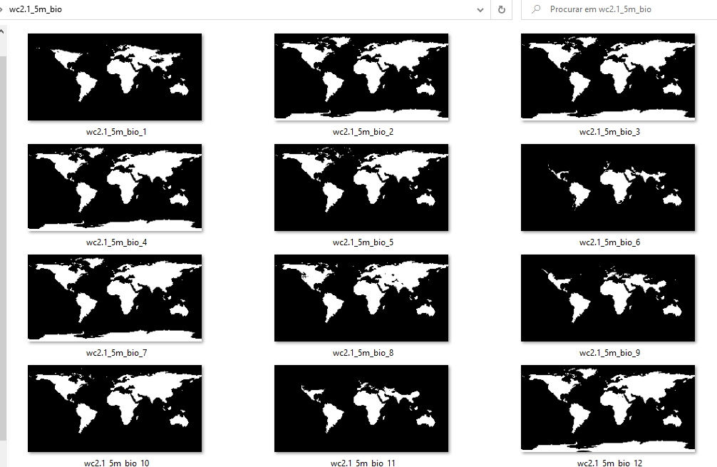
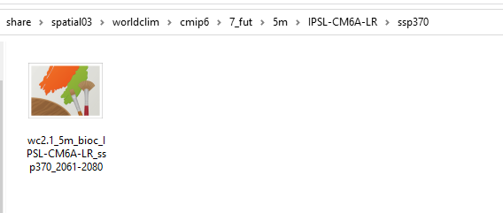
SDM Practical
Once you download, and unzip the files you’ll notice:
Historical data/Present – 19 files in .tif file
Scenario/Future – A single file in .tif format
The “order” of variables is “weird”: Bio1,bio11 … bio19,bio2,bio4
The scenario/future data has 19 bands:
Each band one of the bioclimatic variables, in order
MAXENT requires:
One separate file per variable
Ascii format (.asc)
R code will is adapted for both cases: 01_CroppingEnvVariables.R
Present:
Future:

Slide 23
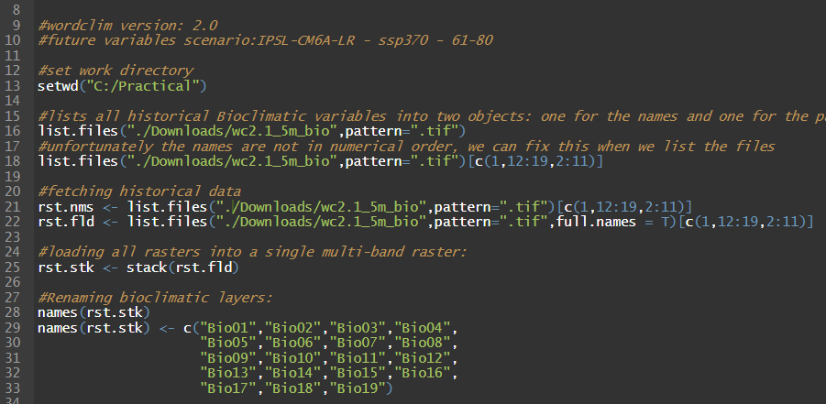
SDM Practical
1
2
3
4
5

Slide 24
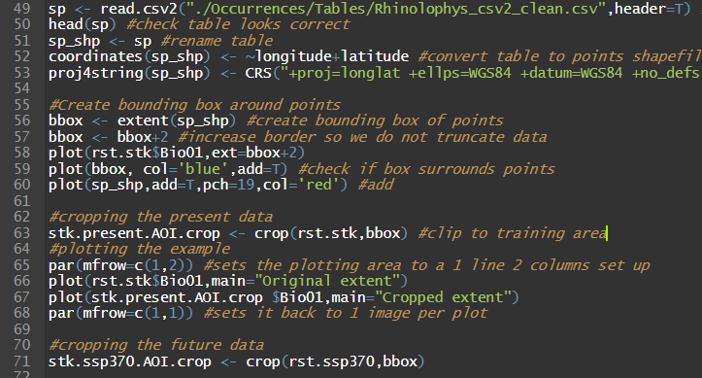
SDM Practical
1
2
3
4
5

Slide 25
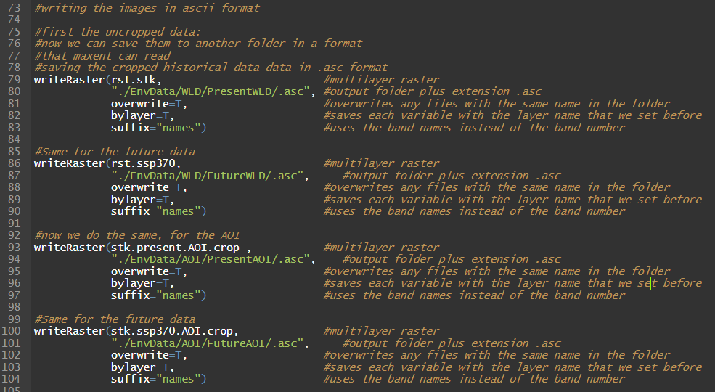
SDM Practical
1
2
3
4

Slide 26
Selecting enviromental variables

Slide 27
SDM Practical
First step:
Considering your ecological knowledge of the species, select a number of bioclimatic variables
5 ~ 10 variables
Second step:
Spearman’s rank autocorrelation test (r) between each pair of variables
Measures statistical association/dependence between two variables
If r > 0.7 between multiple variables, it is a problem
Last step:
Variance Inflation Factor (VIF) using only the environmental variable
Measures the amount of multicollinearity in the model
If VIF > 10 for any of the variables (normally pairs) – you have to remove
All statistical tests have to be done on the AOI
Helps identify which variables might be a problem
Tells you if there is a problem

Slide 28
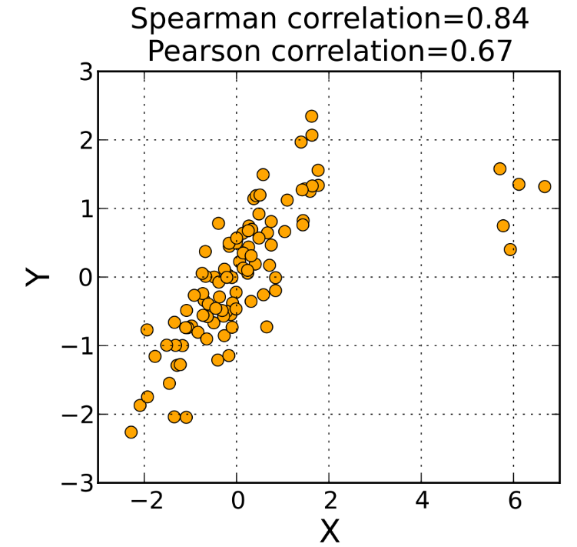
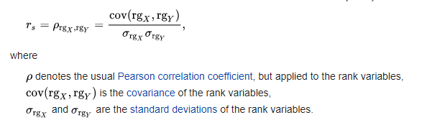
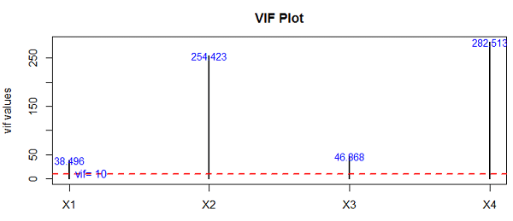
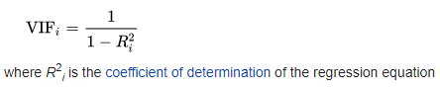
SDM Practical
Spearmans Rank correlation coefficient – R
Variance of Inflation Factor (VIF)
OLS of Variable X ~ of all others
Calculate VIF of variable X in function of all the other variables

Slide 29
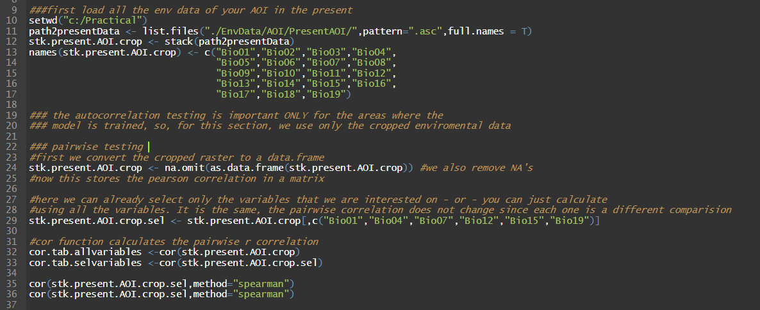
SDM Practical
Script: 02_VariableSelection.R
1
2
3
4

Slide 30
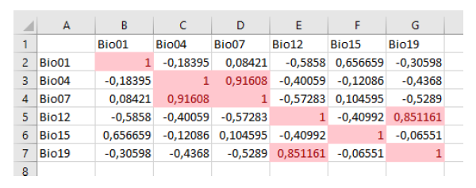
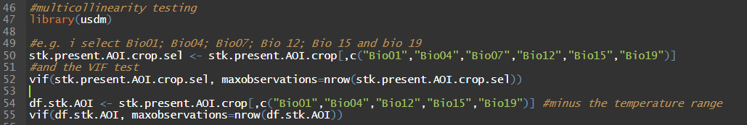
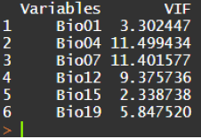
SDM Practical
Some of my variables have high r value
There is only need to remove if VIF > 10
Indeed, we opted to remove Bio07 – “Temperature Annual Range” because we considered seasonality more important in comparision

Slide 31
SDM Practical
You have to repeat VIF test and remove variables until VIF < 10
If you have multiple variables contributing to the VIF
Choose the most important ones, check if VIF is acceptable
You can also try different configuration
The pair comparisions of the Spearmans r do not need to be repeated as nothing changes
Once you finalized the final “structure” of your model, remember the names because you will need them for MAXENT

Slide 32
Starting up MAXENT – Finally!

Slide 33
SDM Practical:
Check-up:
Do you have Java installed and downloaded MAXENT?
Checking java: Open “Command line” and type “java –version”.
Checking maxent: open the .bat file
Regarding occurrence data:
Is it in NA format (decimals as points and separators as commas)
Is the table ordered: Species, longitude, latitude?
Do you have errors in the rows? Different species names, missing values?
Regarding the environmental data:
Do you have the list of the selected variables?
Are all variables (present and scenarios) in .asc format?
Are they saved to different folders so that each last subfolder has a unique name?
Do all the files (not the folders) have precisely the same name?

Slide 34
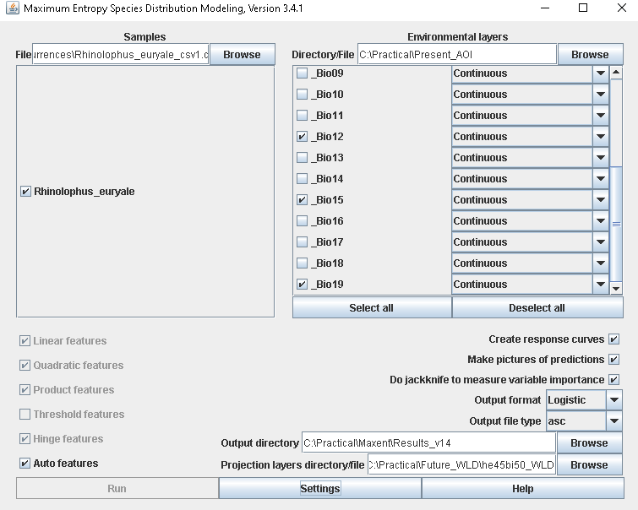
SDM Practical:
Load the enviromental variables – point to the folder
De-select all and then select your variables
Load the occurrences (beware of the type of CSV)
Activate everything and choose logistic output
Press settings for extra options

Slide 35
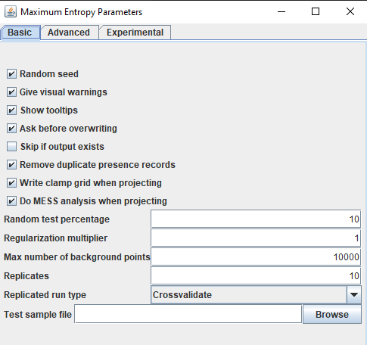
SDM Practical
Tells the algorithm to randomize the sample generation before each validation
Pop-up warnings and interface info
Tests and removes presences that fall in the same pixel – keeps only 1 per pixel
Saves a clamp file when reprojecting and does the MESS analysis
Presence data % used for validation (e.g. AUC etc)
A scalar value multiplier to apply to the regularization parameters
Number of samples to use for estimating the background distribution; AKA Pseudo-absences
Number of replicates (repetitions) and training validation method
Optional external validation dataset

Slide 36
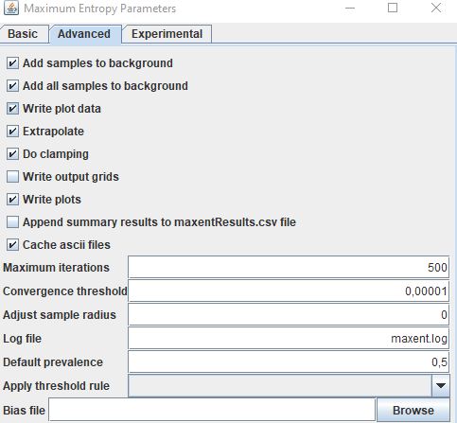
SDM Practical
Equivalent to sampling with replacement or not
Save the data used on the plots (e.g. Response curves)
Allow the model to extrapolate outside the training range
Apply clamping to extraopolation areas
If on, all models will be saved onto the disk in .asc files
Write the plots used in the model report onto the disk
Append the new run to a previous run or start over
Run the machine learning 500 times model or until the convergence is below 0,00001
Cosmetics, changes the size of background data points on the output map
Log file and assumped prior prevalence
Generate a presence/absence map based on the rule
Spatial sampling bias file

Slide 37
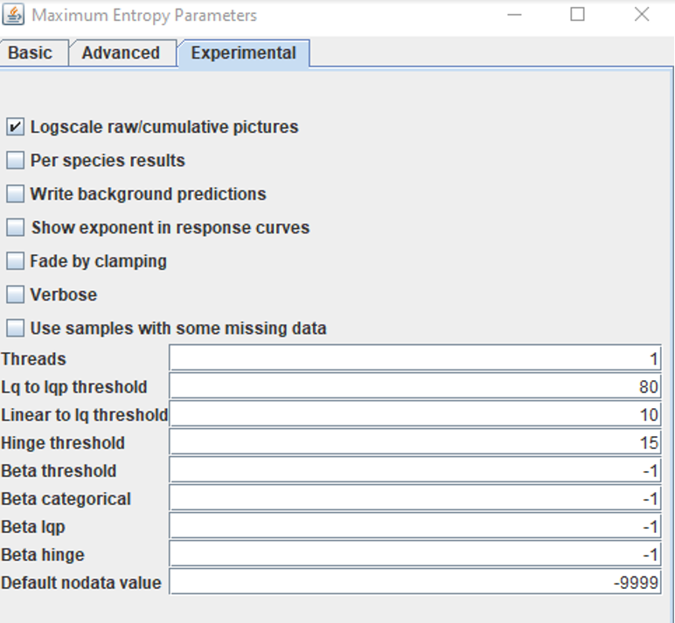
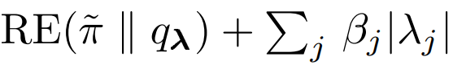
SDM Practical
Mostly cosmetic, and for exploring the outputs.
Fade by clamping alters your outputs
Here: Number of CPU cores the software can use
All these options relate to this equation and within the algorithm parameters
Sets default nodata value

Slide 38
MAXENT – Exploring the outputs

Slide 39
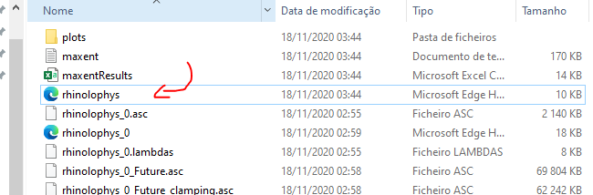
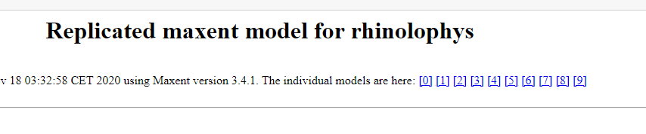
SDM Practical
Open the MAXENT output folder
C:/Practical/Maxent/<etc>
You see a huge number of files
Click the .html with your species name
The one without any number will provide a summary of all the replicates
Each specis_number is the summary of that individual run
The “original” output files are also here, ready to be opened in a GIS
They are the .asc files
Notice, the outputs are in the same coordinate system as the inputs BUT the images to not have any projection information associated with them

Slide 40
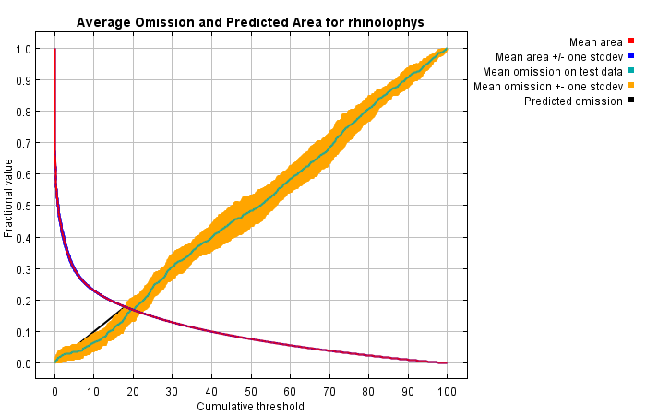
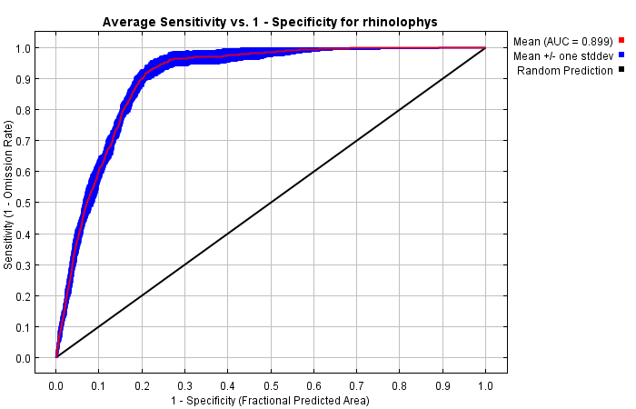
SDM Practical
False negatives
Less random
More random
Total area predicted present
The closer the omission rate (yellow range) is to the predicted omissions (black line) -> the better!
The other curve represents the total area predicted as presence, given the threshold.
AUC-ROC curve for increasing threshold values. The closer to 1, the better (remember the theory!).
The closer to the 1:1 line, the more “random” your prediction

Slide 41
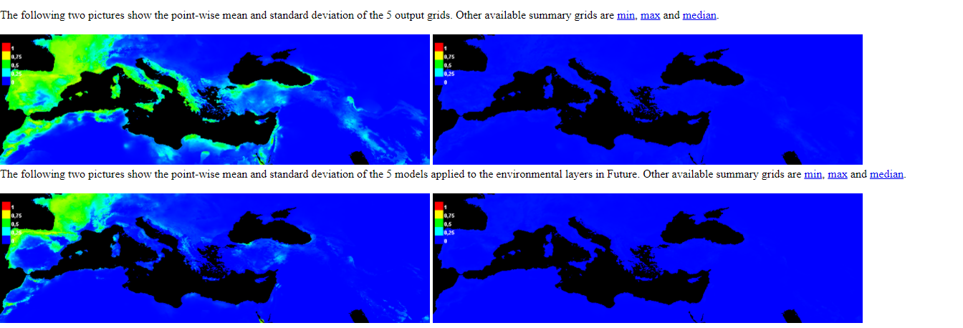
SDM Practical

Slide 42
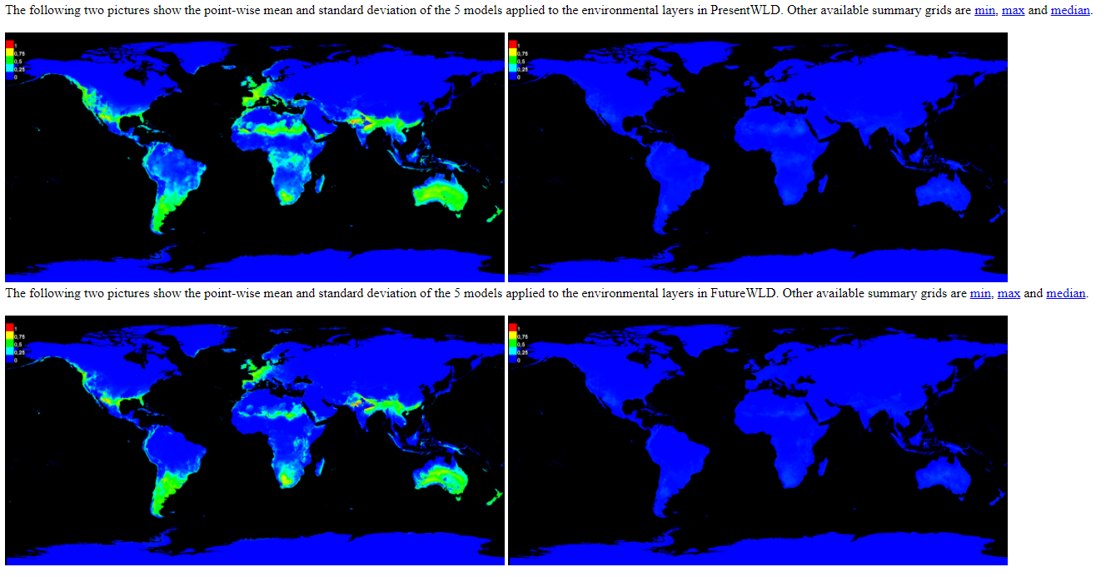
SDM Practical

Slide 43
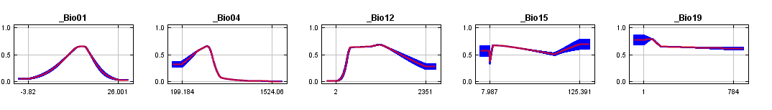
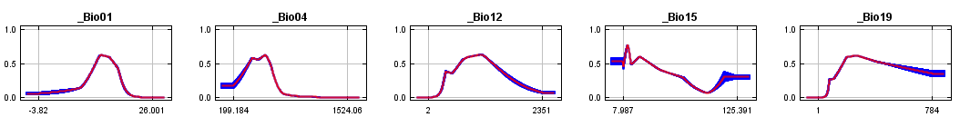
SDM Practical
1)
2)
Bio 1: Annual mean temperature
Bio 4: Temperature seasonality
Bio 12: Annual precipitation
Bio 15: Precipitation seasonality
Bio 19: Precipitation of the coldest quarter
P when varying X variable while keeping all others at the mean value
P when using only variable X

Slide 44

SDM Practical
Percent contribution:
Changes in regularization parameters (PS: bit unclear)
Normalized to [0 – 100]%
Permutation importance:
Changes in training AUC by excluding/including the given variable
Normalized to [0-100%]
Take note:
% contribution ≈ Permutation importance .: Good model
These estimates are highly affected by autocorrelation between variables
Very important for ecologists!
In my case, temperature seasonality was most important
Regularization parameters

Slide 45



SDM Practical
Three types of jacknife testing:
First two:
Gain in regularization parameters (not clear!)
Using training (first) or test data (second)
3rd:
Changes in AUC when variable is included
Clearest test, focus on this one
Very similar to Variable importance
And should be used to help conclude which variables were most important

Slide 46


SDM Practical
If you focus on one of the replicates
On the top of the page, click on one of the [nr]
Mostly is the same summaries but related only with each specific run
With the exception of two important sets of information:
A table showing different possible thresholds
The outcomes of the Multivariate Environmental Similarity Surfaces (MESS) and Most Dissimilar Variables (MOD)

Slide 47

SDM Practical
Here are possible different “Thresholds” you can use to define presence/absence
If Probability > 0.372 then, consider the species to be present
The reasoning behind each threshold varies:
Recommended: Equal test sensitivity and specificity (Generally applicable, but, in some cases might not be reasonable)
Also notice the significance value, should be very close to 0 (< .005)

Slide 48
SDM Practical
These results are given “per replicate”, so how do I select the threshold?
Go through the various replicates and select the mean value of the threshold.
Notice, in your report, you can even let us know your mean value +/- sd -> but it’s up to you how to find out how to do this

Slide 49


SDM Practical
Multivariate Environmental Similarity Surfaces (MESS)
Show areas where your model is most dissimilar (aka different)
The data is also available as a .asc file which you can explore, edit or use in GIS to for example mask regions of high uncertainity
Similar (Blue) <-> Dissimilar (red)
In the “rocky road” scenario, more similar areas seem to be found -> meaning an increase of the available habitat for the species

Slide 50



SDM Practical
Most Dissimilar Variable (MOD)
Show areas which specific variable was found to be most dissimilar for every location
The data is also available as a .asc file which you can explore, edit or use in GIS to for example, to identify which variable is the most limiting or to identify changes in these between the present and the future scenario
In most ranges and especially in the areas where the habitat was predicted -> there was no significant problem
Some changes from None -> Bio 15 (Precipitation seasonality) in the artic regions
Various changes in the “amazon” (Bio14 Precipitation -> various others) -> could it be because of less precipitation due to climate change?

Slide 51
MAXENT – My outputs

Slide 52


SDM Practical
In summary:
AUC = .89
~ moderate (I general) -> but remember my species distribution is somewhat specialist
Can be that I would need more samples in the middle east to have a better picture
There are indications of a decrease in habitats in the training region
Which is problematic for the conservation of the species
Can be quantified by change maps

Slide 53

SDM Practical
In summary:
This indication of habitat loss seems to be in-line with the global distribution
But further quantification with the change map will confirm (or not) this visual inspection
Interestingly, there are many regions likely invadable
Global south, regions with similar Mediterranean climates
California and Mexico/Texas (also similar climates)
Near the Tibetan/Chinese border

Slide 54




SDM Practical
Most important variable for the species distribution was:
Bio 04 - Temperature seasonality
Both on the permutation tests as well on the jacknife testing.
Other highly significant variable was:
Bio 12 – annual precipitation
If I look into the response variables I can get an idea of the “ideal” ranges of the species:
Not “too much” seasonality
Mid-high precipitation

Slide 55






SDM Practical
Mediterranean horseshow bat
According to wikipedia:
Notice: i did NOT use elevation
But still “learned” the pattern

Slide 56




SDM Practical
MESS & MOD in training area:
Absolutely no reason not to be confident in my models when predicting to the future (~50years)
MESS & MOD for the globe (Present):
Some risk in the tropical regions & the poles

Slide 57


SDM Practical
MESS & MOD for the globe (Future):
More risk in the tropical regions & the poles
More risk near the actual current distribution ( north of the sahara)

Slide 58

SDM Practical
Now, using R outputs (ugly maps!)
You can do better using GIS
Probability maps
This is equivalent to the maxent results
We can already see see that there are very big differences in probability
Habitat suitability seems to displace northwards
Inline, with increasing temperatures and changes in precipitation

Slide 59

SDM Practical
Presence/Absence maps
But now using the thrshold
More easily visible the displacement of suitable habitat
Again, you can make nicer maps using GIS
And following the 10 golden rules!

Slide 60

SDM Practical
Legend:
Green: Gain
Gray: Maintained (where it was absent)
Yellow: Maintained (where it was present)
Red: Loss

Slide 61
SDM Practical
 | R variables | Description | PixelCounts | Metrics | Percentage | Formula | R variables
Habitat change | Gain | Gain | 23367 | Habitat gain | 9,743% | Gain/(Disa+Stable1) | PercLoss
 | Stable0 | Maintained (Absent -> Absent) | 2905195
 | Stable1 | Maintained (Present -> Present) | 151248 | Habitat loss | 36,939% | Disa/(Disa+Stable1) | PercGain
 | Disa | Loss | 88596
 | CurrentRangeSize | Current range size | 239844 | Species range change | -27,196% | Habitat Gain - Habitat loss | SpeciesRangeChange
 | FutureRangeSize0Disp | Future range size (no migration) | 151248
 | FutureRangeSize1Disp | Future range size (migration) | 174615
The biomod function BIOMOD_RangeSize summarizes everything for us
And thus, its confirmed a loss of ~27% of the habitat

Slide 62





A curve ball:
Two models trained with different variables
Extremely similar (almost equal)
Why do you think that is?
“Correct” variables
“Incorrect” variables

